Slide 1
Loan Sanction Amount Prediction
IV Year B.Tech – Mini Project Review (Review-1)
Team Members Details
D.Saikiran 20N31A6714
M.Luckydhar 20N31A6741
MD.Rehan pasha 20N31A6742
III Year B.Tech – CSE Data Science
Under the Guidance of
Mrs. Ch.pavithra
Asst. Professor & Dept Of Emerging Technologies

Slide 2
Outline
Abstract
Introduction
Existing System
Proposed System
Difference between Existing and Proposed
Literature Review

Slide 3
Abstract
This project aims to develop a predictive model for estimating loan sanction amounts using a Decision Tree Regressor.
By leveraging historical loan application data and various applicant attributes, such as financial profiles and credit history, the model seeks to provide accurate and transparent loan sanction recommendations.
This project holds significant potential for enhancing decision-making processes in the lending industry while ensuring fairness and transparency in loan approval procedures.

Slide 4
Introduction
In the dynamic landscape of the financial industry, the accurate prediction of loan sanction amounts is of paramount importance for both lending institutions and loan applicants.
This project explores the application of Decision Tree Regressor, a powerful machine learning algorithm, to tackle this challenge.
By leveraging historical data and applicant attributes, this project endeavors to create a reliable model that can assist in determining appropriate loan sanction amounts, thereby facilitating informed and equitable lending decisions.

Slide 5
Existing System
The current loan sanctioning process in many financial institutions relies heavily on manual evaluation and subjective decision-making, leading to inconsistencies and inefficiencies.
Traditional methods often lack transparency, making it challenging for applicants to understand the basis for loan approval or rejection. This approach also carries the risk of human bias.
Furthermore, it does not harness the power of machine learning to leverage historical data and applicant profiles for accurate loan amount predictions. Thus, there is a pressing need for a data-driven solution to enhance the loan sanctioning process.

Slide 6
Proposed System
The proposed system introduces an innovative approach to loan sanction amount prediction by implementing a Decision Tree Regressor-based model.
This system leverages historical loan application data, financial metrics, and credit history to provide automated, data-driven loan sanction recommendations. By doing so, it aims to address the shortcomings of the existing manual system, offering greater accuracy, transparency, and fairness in the lending decision process.
Additionally, it reduces the potential for human bias and enhances the overall efficiency and effectiveness of loan sanctioning for financial institutions and applicants alike.

Slide 7
Existing <vs> Proposed System
Existing System: The existing system relies on manual evaluation, lacks transparency, and is susceptible to human bias, resulting in inconsistent loan sanction decisions.
Proposed System: The proposed system employs a Decision Tree Regressor model, leveraging historical data for accurate, transparent, and unbiased loan sanction amount predictions, enhancing efficiency and fairness in the lending process.

Slide 8
Literature Review
L. Yang, X. Zhu, L. Chen, "Predicting Loan Eligibility for Home Loans," IEEE International Conference on Data Science and Advanced Analytics (DSAA), 2015.
Y. Zhang, H. Lu, Z. Wang, "A Deep Learning Model for Predicting Loan Quality," 2019 International Joint Conference on Neural Networks (IJCNN), Budapest, Hungary, 2019.
M. Agarwal, R. Nagar, "Predicting Loan Defaults: A Case Study," European Journal of Operational Research, Volume 230, Issue 2, 2013, Pages 364-373.
D. Shin, M. R. Haghani, H. S. Mahmassani, "Predicting Mortgage Loan Delinquency with Dynamic Bayesian Networks," Transportation Research Part C: Emerging Technologies, Volume 18, Issue 6, 2010, Pages 833-845.
T. Li, S. C. Hoi, "Loan Application Result Prediction on Imbalanced Data," IEEE Transactions on Knowledge and Data Engineering, Volume 26, Issue 10, 2014, Pages 2528-2542.

Slide 9
Architecture Diagram or System Diagram

Slide 10
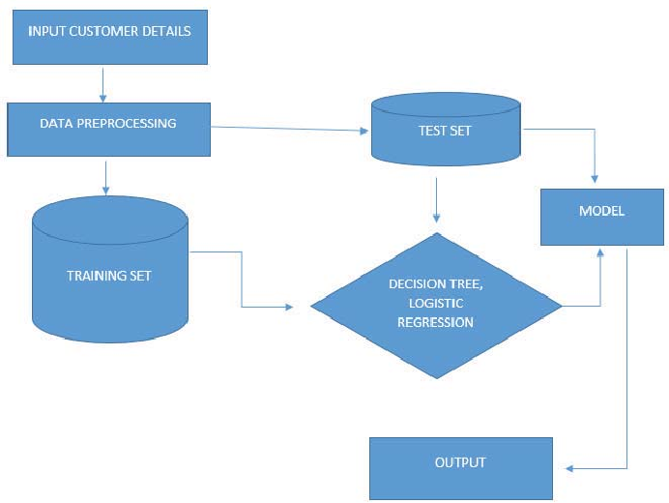
System Architecture

Slide 11
Software Requirements Specification (SRS)

Slide 12
Software Requirement (SRS)
Essential software requirements
Python
Google collaboratory
Python Libraries
NumPy: For numerical operations.
pandas: For data manipulation and analysis.
scikit-learn: For machine learning algorithms, including Decision Tree Regressor.
Matplotlib and Seaborn: For data visualization.
Note: In the context of a "Loan Sanction Amount Prediction" project, the terms "front end" and "back end" are not typically used as they are in web development.

Slide 13
Hardware Requirement
Processor (CPU):
Multi-core processors (e.g., Intel Core i7, Xeon) for parallel processing and faster data computation during training and prediction.
Memory (RAM):
A sufficient amount of RAM (e.g., 16GB to 32GB) to handle large datasets and complex machine learning models efficiently.
Storage:
Solid State Drive (SSD) with ample storage space (e.g., 500GB to 1TB) for storing datasets, model checkpoints, and application code.
Graphics Processing Unit (GPU) (Optional):
High-end GPUs (e.g., NVIDIA GeForce RTX series, Tesla series) to accelerate training of deep learning models and speed up computations.
Network Connectivity:
High-speed internet connectivity for accessing cloud services, updating models, and deploying the application.

Slide 14
Application Modules
Module -1 : Data Collection Module
Module -2: Data Preprocessing Module
Module -3: Machine Learning Module
Module -4: Testing and Validation Module

Slide 15
Class Diagram
LoanApplication applicant_info: ApplicantInfo | | - credit_history: CreditHistory | | - financial_data: FinancialData | | - loan_amount: float | | - decision_tree_model: DecisionTree +submit_application(): void +get_loan_sanction_amount(): float | ApplicantInfo name: string - age: int | | - employment_status: string | (other applicant attributes) | | | | +get_applicant_info(): ApplicantInfo| | +set_applicant_info(): void
CreditHistory credit_score: int | | - credit_history_length: int | | - ... (other credit history details) | | | | +get_credit_history(): CreditHistory| | +set_credit_history(): void | DecisionTree trained_model: DecisionTreeModel +train_model(): void +predict_loan_amount(): float

Slide 16
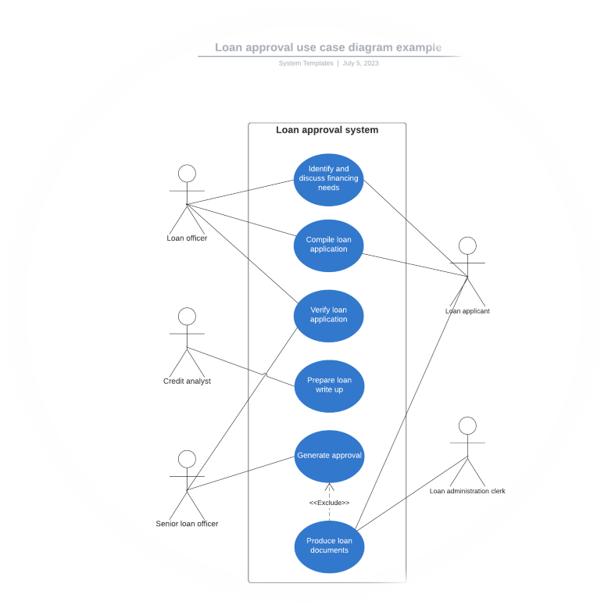
Use-Case Diagram

Slide 17
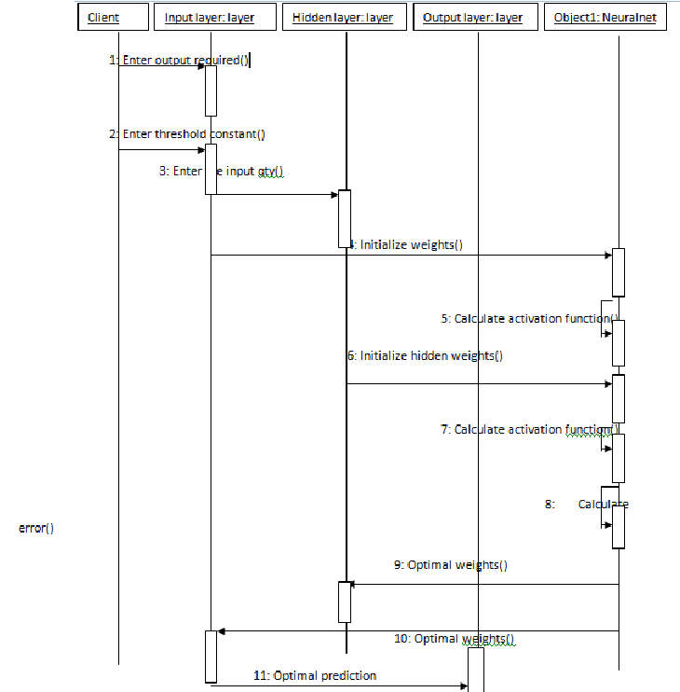
Sequence Diagram

Slide 18
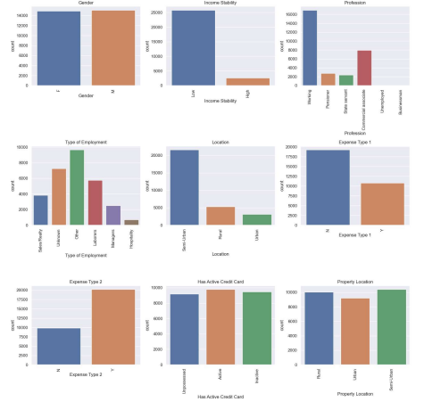
Output Screen
List Of Considerations

Slide 19
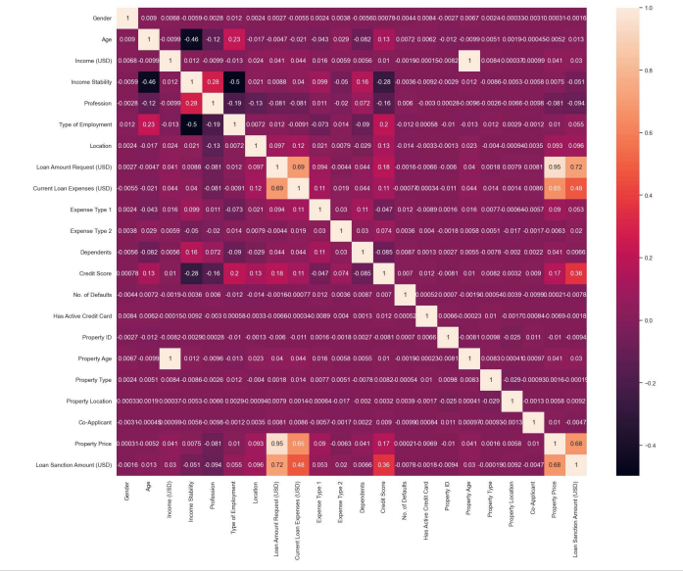
Corrleation Table

Slide 20
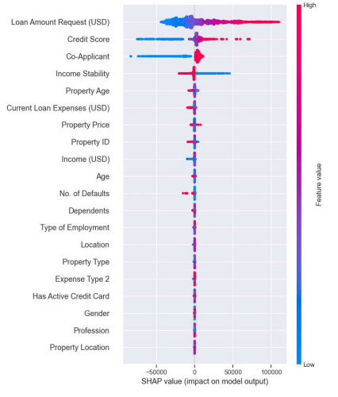
Feature value

Slide 21
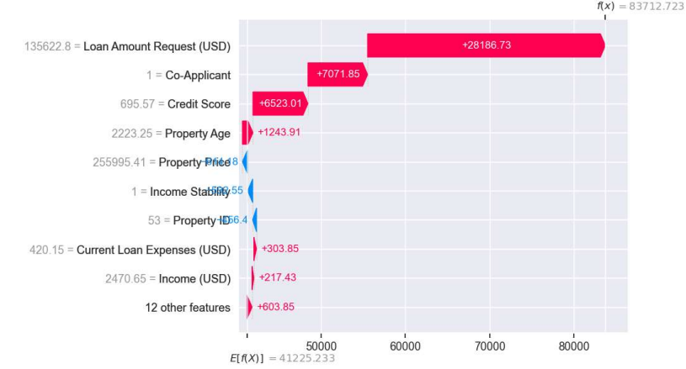
Describes Features

Slide 22
About your Application
The "Loan Sanction Amount Prediction using Decision Tree Regressor" application is a comprehensive financial tool designed to streamline and automate the loan approval process.
It collects and preprocesses applicant data, including financial profiles and credit history, then utilizes a trained Decision Tree Regressor model to provide accurate predictions for loan sanction amounts.
This application offers a data-driven, fair, and user-centric approach to lending decisions

Slide 23
Status of the Application Development
The current status of the application development of application is finished

Slide 24
Tentative Date of Application Completion
Our Application Will be completed by Mid of October with all functionalities

Slide 25
Thank you
D.Saikiran 20N31A6714
M.Luckydhar 20N31A6741
MD.Rehan pasha 20N31A6742

